Slide 1

Notes:
Lewis: GoodMorning, First thing first, Head to this google link, and lets get you downloading the necessary packages.

Slide 2


Slide 3
HTML Background
What is HTML?
Stands for Hyper Text Markup Language
Markup languages are “a system for annotating a document in a way that is visually distinguishable from the content”

Slide 4
HTML Basics
Elements
The building blocks used to construct HTML documents
HTML elements typically have a start tag, some content, and an end tag
<tagname>Content</tagname>

Slide 5
Essential HTML Elements
<!DOCTYPE html>
Declaration of an HTML document
<html>
Root element of the page
<head>
Contains metadata for page (page title, stylesheets)

Slide 6
Basic HTML Elements cont.
<body>
Contains body of page, all visible elements
<div>
Basic container, mainly used for styling
<p>
Defines a paragraph

Slide 7
Basic HTML Elements cont.
<a>
Defines a hyperlink, used for page navigation
<h(1-6)>
Header element, 1 is largest, 6 is smallest
<p>
Defines a paragraph

Slide 8
HTML Attributes
Some HTML tags can have attributes
<a target="_blank"href="https://thesoda.io">
Attributes are defined in the starting tag and specify more information about it
Can be used to link to CSS or JavaScript code!

Slide 9
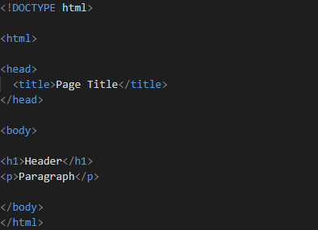
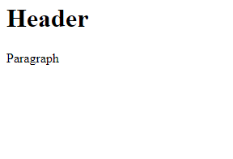
HTML Example

Slide 10
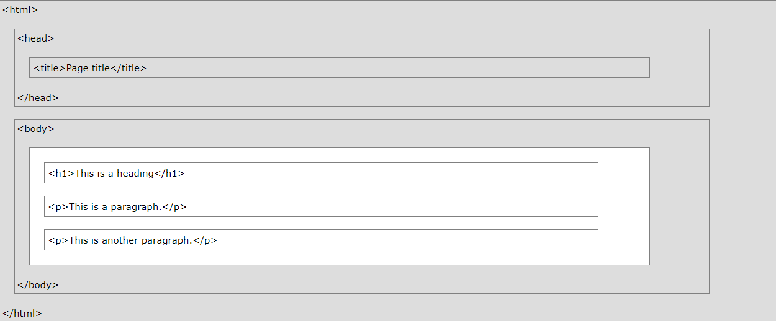
HTML Example

